Slide 1
Absolute Zero

Slide 2
Deepseek-R1(2025.02): Data + GT COT
TTRL(2025.04):Data GT
Absolute Zero(2025.05): Data

Slide 3
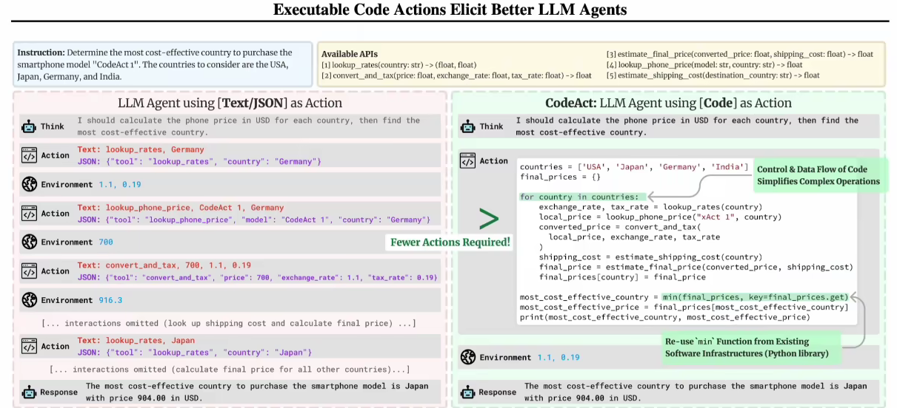

Slide 4
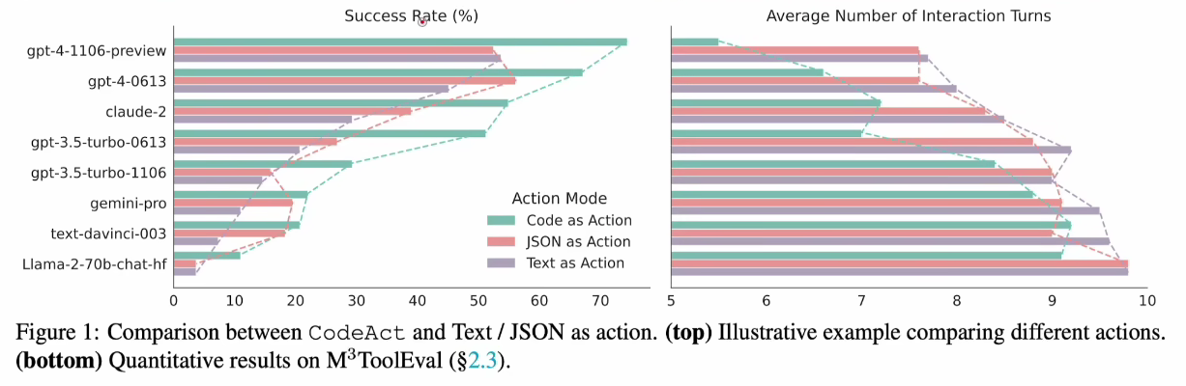

Slide 5
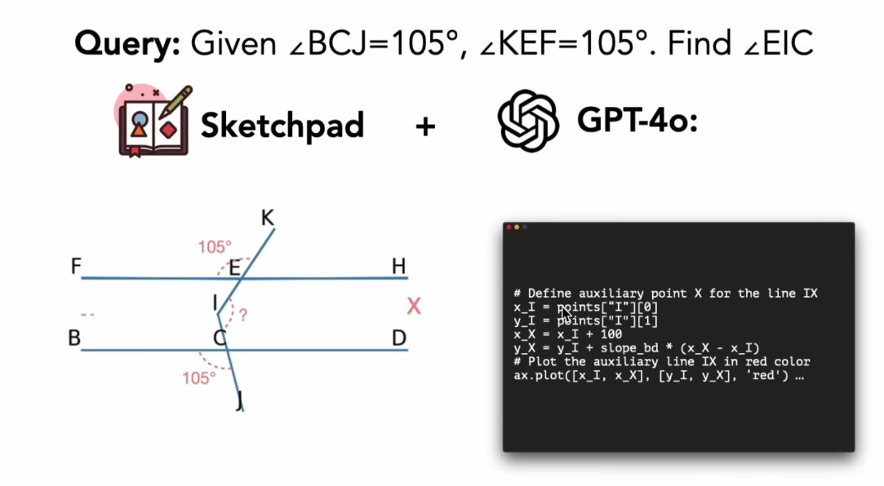
Visual SKETCHPAD: Sketching as a Visual Chain of Thought for Multimodal Language Models

Slide 6
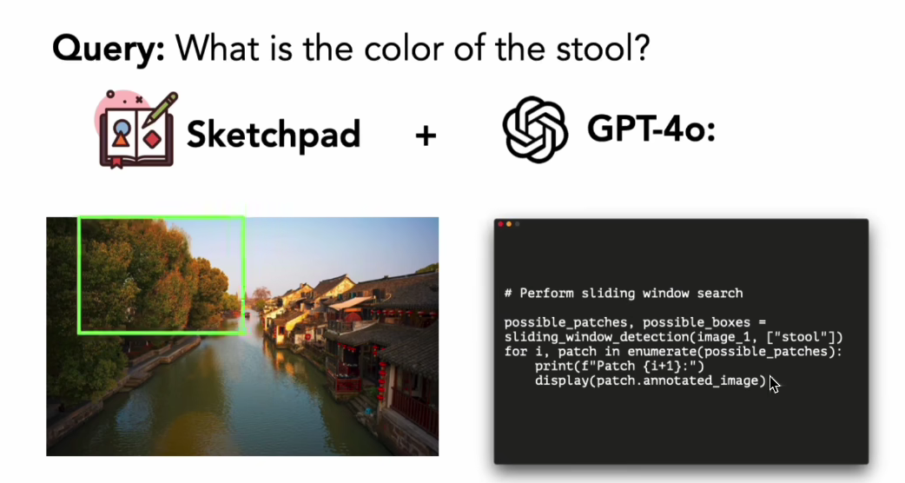
ICLR

Slide 7
AZR
Supervision
Reasoning
Self-evolves

Slide 8
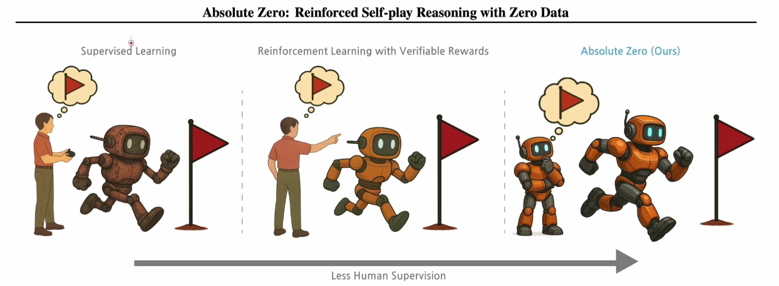

Slide 9
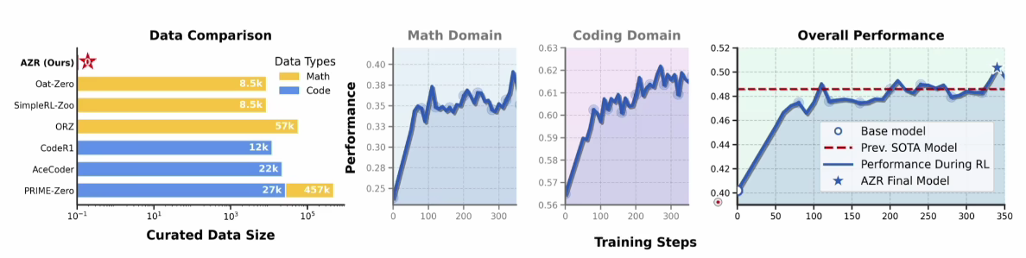

Slide 10
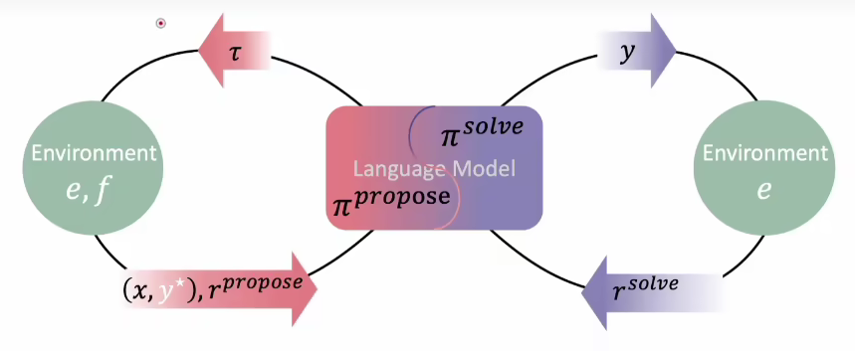

Slide 11
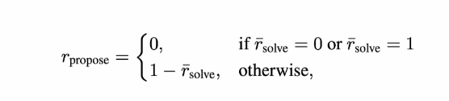

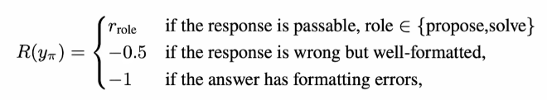

Slide 12
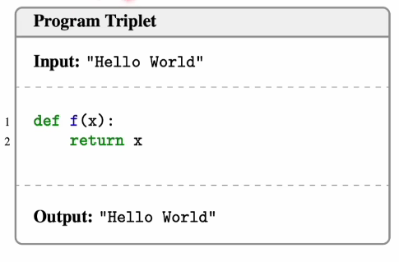
1.Deduction(演绎;I P → o)
2.Induction(溯因;P O → I)
3.Abduction(归纳;I O → P)

Slide 13
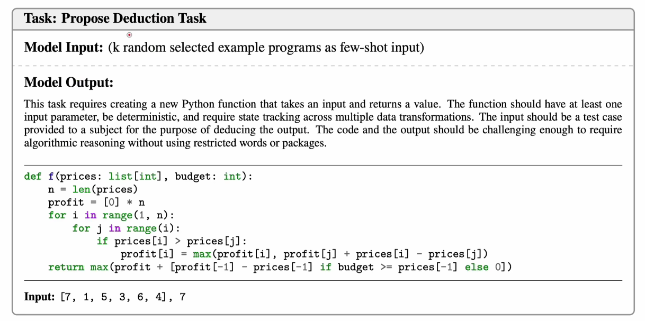

Slide 14
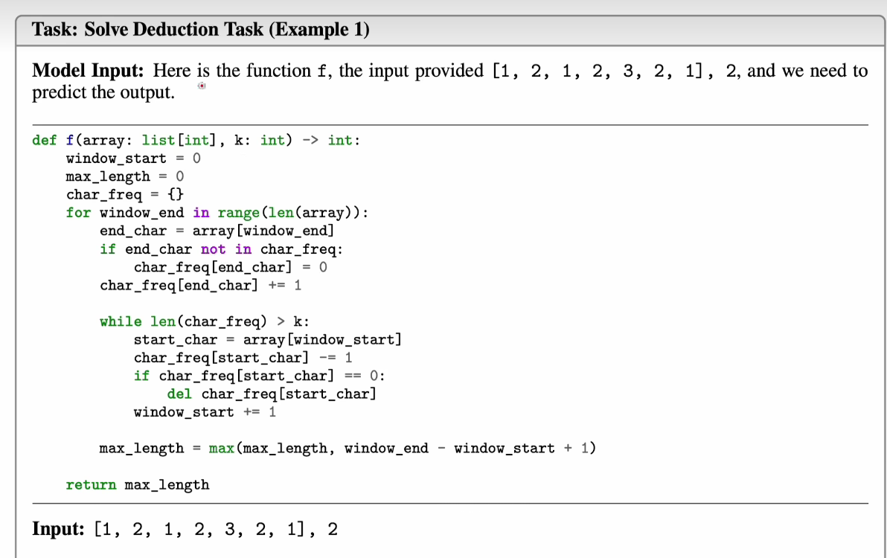

Slide 15
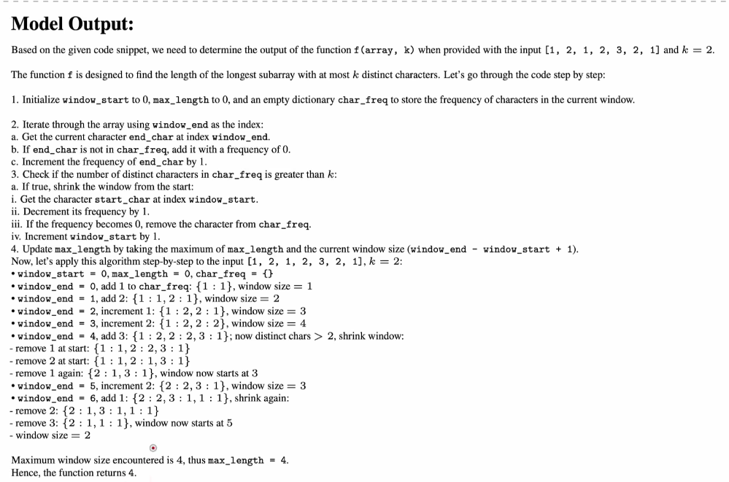

Slide 16
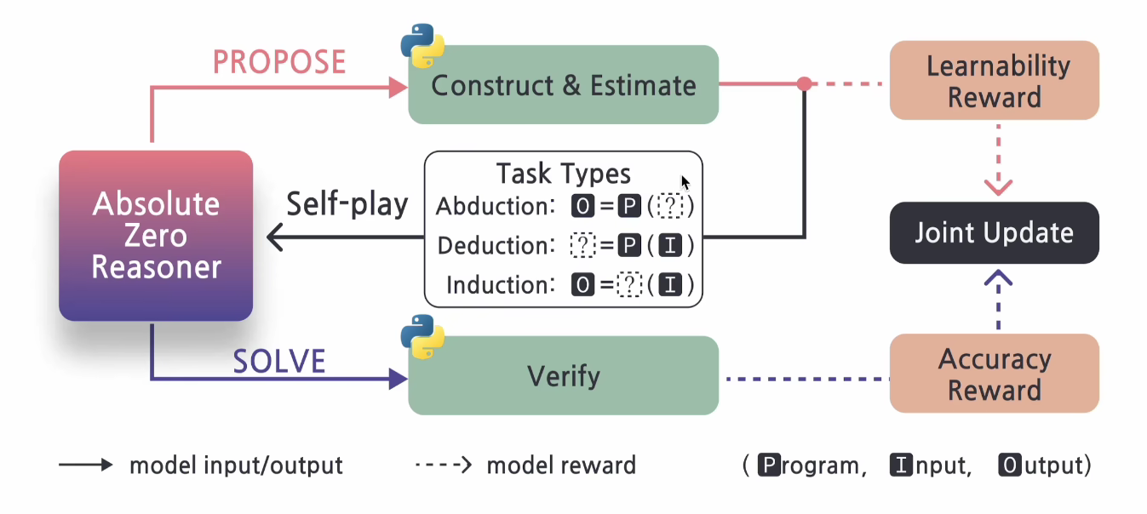

Slide 17
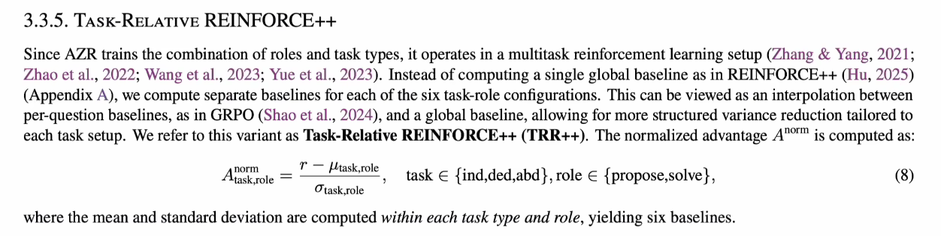

Slide 18
